Slide 1





EMPLOYEE
ATTRITION
ANALYSIS
Presented by Bhanu Sharma

Slide 2






Problem Statement
I have to play an HR Analyst Role in this project regarding the attrition of a company XYZ to find out why employees are leaving the company and reduce the attrition rate by building a visually immersive interactive dashboard by analyzing the key factors that can help the organization make data-driven decisions.

Slide 3


PROJECT WORKFLOW
Data Exploration and Cleaning
PowerBI Dashboard Creation
DAX Functions & Data Analysis
Visualization & Insights
Data Storytelling & Recommendations

Slide 4

Attrition Overview
Out of 4300 employees, 695 have left the company, resulting in a 16.2% attrition rate. On average, employees were 37 years old and had worked for 7 years. Notably, 430 male and 265 female employees contributed to the attrition statistics..
INSIGHTS
GENERATED
Tenure Trends
A significant portion of attrition occurred within the first year of employment, highlighting the importance of early engagement and retention efforts.
Age Group Analysis
Employees between the ages of 26-35 were observed to have the highest attrition rates, signaling potential challenges in retaining this demographic segment.

Slide 5
Educational Background Impact
INSIGHTS
GENERATED
Attrition was notably observed among employees with educational backgrounds in life sciences and medical fields, indicating potential areas for targeted retention initiatives.
Job Role Insights
Certain job roles, such as sales executives, research scientists, and laboratory technicians, experienced higher attrition rates, warranting focused attention on retention strategies tailored to these positions.
Salary Influence
Employees earning less than 40k salary demonstrated a higher likelihood of attrition, emphasizing the importance of competitive compensation and benefits packages in retention efforts.

Slide 6
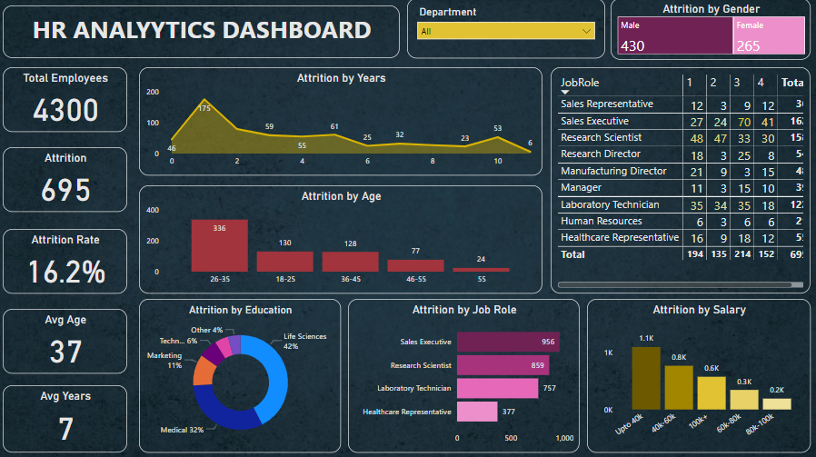
MY DASHBOARD

Slide 7
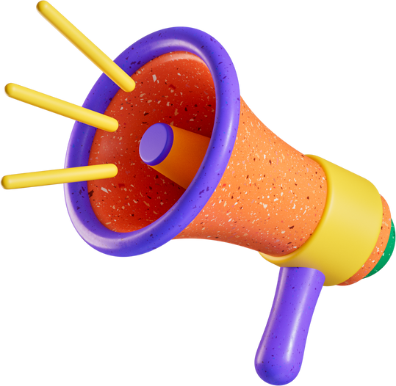
Early Engagement Programs
Develop comprehensive onboarding programs specifically targeting employees in their first year of employment. Focus on integrating them into the company culture, clarifying job expectations, and providing mentorship to support their transition.
Recommendations/ SUGGESTIONS
Retention Initiatives for Age Group 26-35
Implement targeted retention initiatives tailored to the needs and preferences of employees aged 26-35. This could include career development opportunities, mentorship programs, and initiatives to improve work-life balance
Specialized Support for Certain Educational Backgrounds:
Offer specialized support and resources for employees with backgrounds in life sciences and medical fields. This could involve career development opportunities tailored to their specific expertise or additional support for professional growth within their field.

Slide 8
JobRole Specific Retention Strategies
Develop job role-specific retention strategies for sales executives, research scientists, and laboratory technicians. This might include offering additional training and development opportunities, recognizing their contributions, and creating pathways for advancement within their respective roles.
Recommendations/ SUGGESTIONS
Competitive Compensation Packages:
Review and adjust salary structures to ensure competitiveness, particularly for employees earning less than 40k. Conduct regular salary benchmarking exercises to stay aligned with industry standards and address any discrepancies to retain valuable talent.
Employee Wellness Programs
Introduce wellness programs aimed at promoting work-life balance and reducing stress among employees. This could include initiatives such as wellness workshops, mindfulness training, and access to mental health resources to support employee well-being and reduce burnout.

Slide 9

THANK YOU

